Slide 1
Arduino Workshop #3
Reading Analog Sensors
Notes:
24 – Arduino Uno
24 - Small bread board
24 – Jumper wire sets
24 - 10 kΩ potentiometer
48 – 10 kΩ resistor
72 – 220 Ω resistor
24 – USB cables
24 – photoresistors
24 - TMP36 temperature sensor (or any other 5 V analog sensor)
24 – 5mm common-cathode RGB LED

Slide 2
Why we still need analog in a “digital world”?
Observable features are analog
they can assume any number of potential states
Color of sunlight
Temperature
Concentration of contaminants in the air
So we need a way to distinguish between analog and digital inputs and convert between the two

Slide 3
Analog to digital converter
Suppose you want to measure the brightness of the room (measured in lux - it could be any decimal from 0 to ∞)
Pitch black - output 0 volts
Completely saturated - outputs 5 volts
Half saturated - outputs 4.5 volts
⅓ saturated - outputs 1.6666 volts
etc.
You need to use the analog to digital converter (ADC) built into the Arduino to read this value

Slide 4
But what is a ADC doing?
In the Arduino
10-bit ADC
This means that the ADC can subdivide (or quantize) an analog signal into 2¹⁰ different values
2¹⁰ = 1024
So from the reference voltage (5 v)
2.5 v is mapped to 512 (½ of 1024)
1.25 v is mapped to 256 (¼ of 1024)
etc.

Slide 5
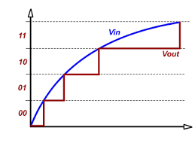
Visual of what’s happening
Here is a 2 bit ADC, it has 2 bits of resolution and therefore 4 total logic levels (2² = 4)
The higher the resolution the more “steps” in the digitized signal (remember the Arduino has 10 bit resolution… so 1024 steps)

Slide 6
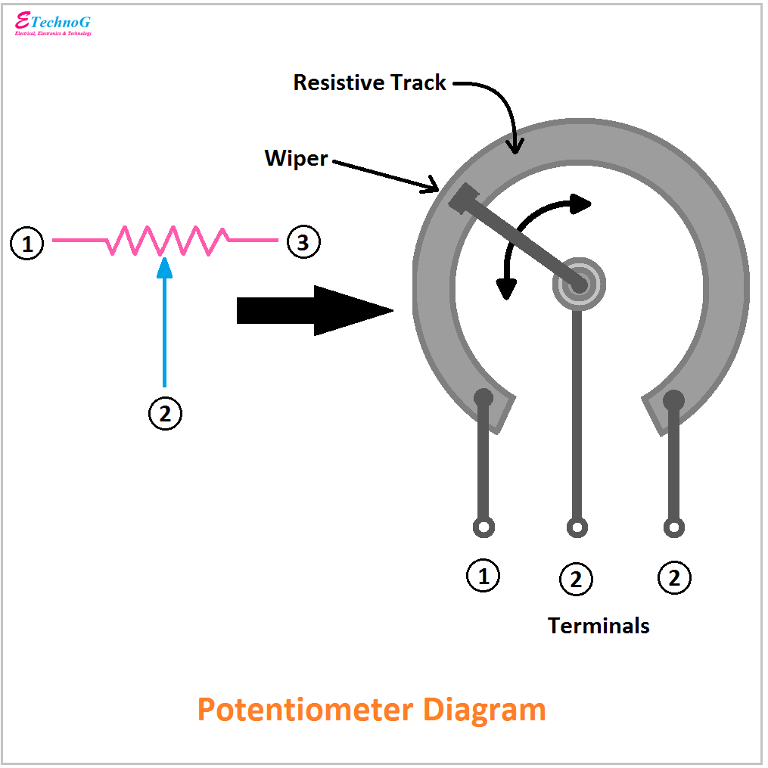
Reading analog signals
Let's start with a potentiometer
Pot for short
Used in
car stereos
Thermostats
speakers
Etc.
3 pins
Outer is grounded (symmetrical so it doesn't matter which side)
Other side pin is connected to high (5 v)
Inner pin is connected to low (0 v)
As you turn the knob you are changing the resistance and thus the output voltage (by ohm's law) to any value between 0 v and 5 v

Slide 7
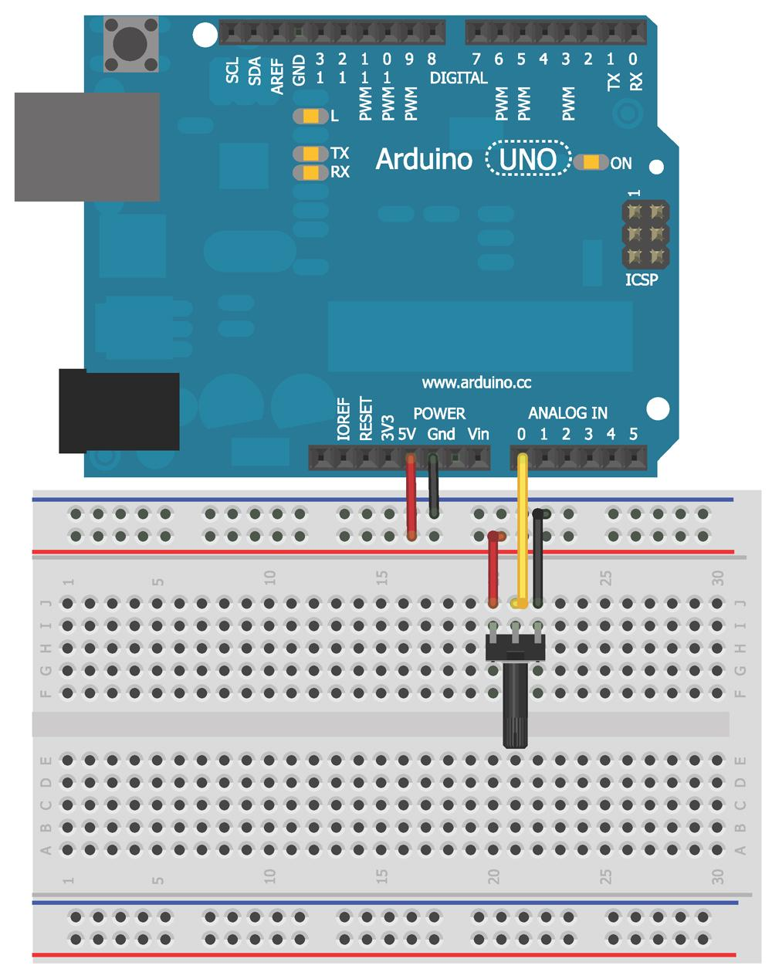
Lets wire up a circuit

Slide 8
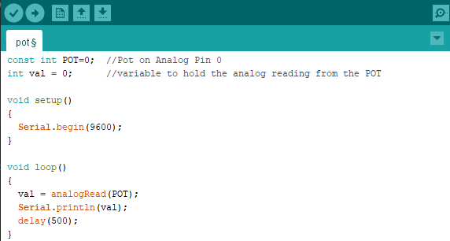
Write the code to see the readings

Slide 9
Notice the new functions
analogRead()
This function reads the value of the analog pin connected to the Arduino
Serial.println()
This function prints to the Arduino IDE serial monitor
serial.begin()
In the setup section
Takes an argument that specifies the communication rate (baud rate)
Faster baud = more data in less time
Can induce transmission error
9600 is common value (and will be the standard we use)

Slide 10
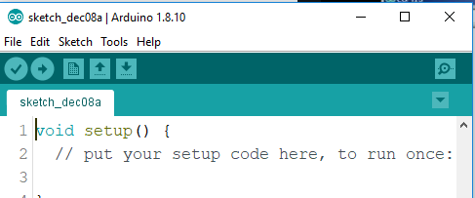
What you should see
The TX LED on the Arduino should be blinking every 500 ms
This indicated the Arduino is transmitting data
After launching the serial monitor you should see a window w/ numbers streaming by
Turning the dial the numbers should go up and down (corresponding to the position of the potentiometer)
One way goes toward 0
The other towards 1023
If you are getting “funky data” you need to ensure the baud rate is correctly set on the monitor
Serial Monitor

Slide 11
Use an analog sensor to sense temperature

Slide 12
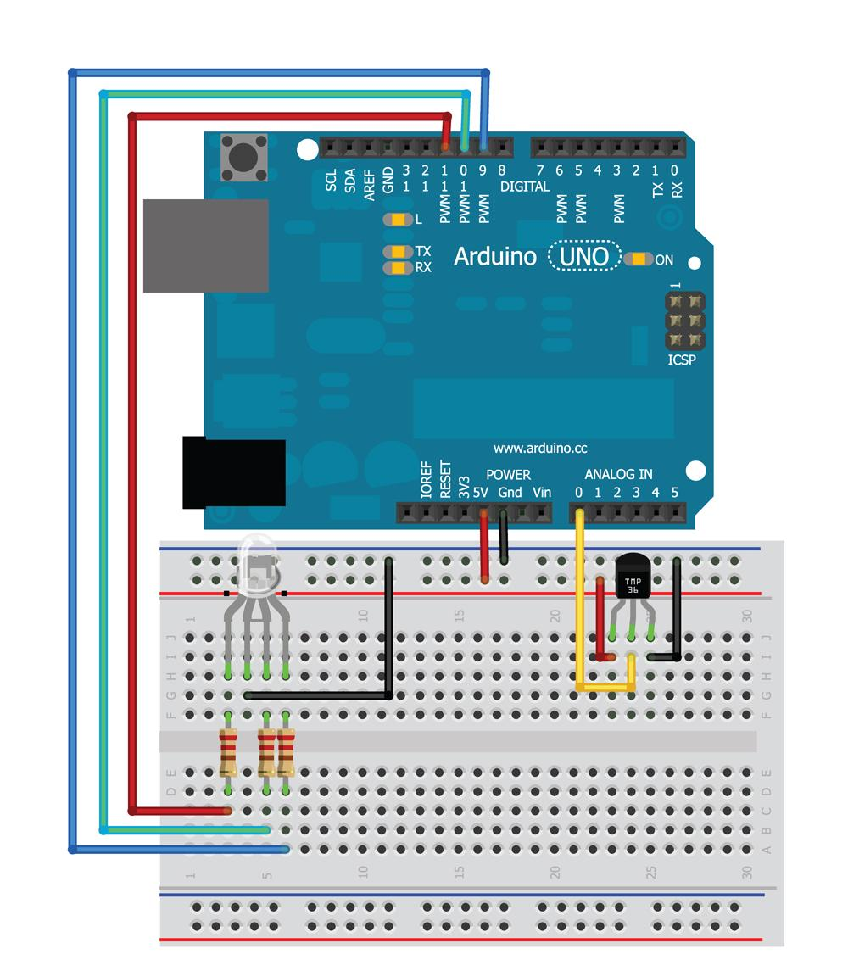
Wire it up

Slide 13
Before we can begin
We need cut offs
Using the same concepts as before we can find
Launch the sketch from before and see what “room temp” corresponds to
When writing this 20⁰ C was about 143 (these will be different for you)
Do a bit of math
Temp (⁰ C) x 10 = voltage ( mV ) - 500
From here we can see that if we want to set upper and lower points all we need to do is solve for the voltage then we can convert that to use in the Arduino
For my 20⁰ C room
20 * 10 = x -500
X = 700 mV
700 mV / (5 V) = Y / 1024
Y = 143.36 (which is 143)
You need to do this for two other temps (2 degrees higher and 2 degrees lower)
These will be the temp that changes the light

Slide 14
Try it yourself first
Goal to get to
Try to write a code that
When the temperature is with in “room temp” ± 2 ⁰C the led is Green
If the temp is lower than that the LED is Blue
If the temp is higher than that the LED is Red
You don't need any new concepts
This is simply building on the concepts from session 1 & 2 (plus the concepts from today)
In about 10 minutes we will go over how one possible code looks

Slide 15
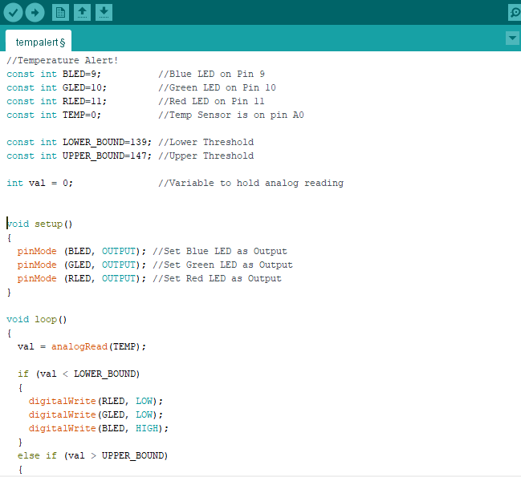
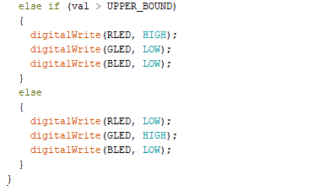
One possible code

Slide 16
make your own analog sensor

Slide 17
Thanks Physics
Not all resistors are constant value of resistance
Conductivity changes resistance when stressed
Force sensors
Flex sensors
Some semiconductors change resistance due to light
Photoresistors
Metals change resistance due to temperature
Thermistors
We can take advantage of this with a voltage divider (so we can measure the change in resistance)

Slide 18
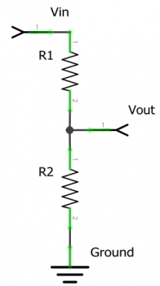

What is a resistive voltage divider?
Uses two resistors to output a voltage that is some fraction of the input voltage
Output is directly related to the value of the 2 resistors
If one resistor is variable you can monitor the ΔV and calculate the ΔR
$$V_{out }= V_{in}\frac{R_{1}}{R_{1}+ R_{2}}$$

Slide 19
Add in a photoresistor
A photoresistor
Changes resistance based on the amount of light it receives
Darker is higher resistance
Whether you replace R₁ or R₂ and the value you choose for the fixed resistor will affect your reading
Scale and Precision
Experiment and look at your serial monitor
Once you have a idea
Find values of a “dark” room
Find values of a “light” room

Slide 20
Start coding
recall
analogWrite()
Sets the brightness of the LED
Accepts values between 0 and 255
New function
map()
Output = map(value, fromLow, fromHigh, toLow, toHigh)
Value - the information you start with
Most recent reading from analog input
fromLow and fromHigh
Input boundaries
Min and Max brightness
toLow and toHigh
Values you want to map to
255 and 0 (swapped to turn off the light when bright)

Slide 21
New function
map()
Output = map(value, fromLow, fromHigh, toLow, toHigh)
Value - the information you start with
Most recent reading from analog input
fromLow and fromHigh
Input boundaries
Min and Max brightness
toLow and toHigh
Values you want to map to
255 and 0 (swapped to turn off the light when bright)
constrain()
constrain(value, min, max)
Constrains the value given between 2 values
If the photo resistor measured to high you would pass below 0 (its inverted to turn off in light)

Slide 22
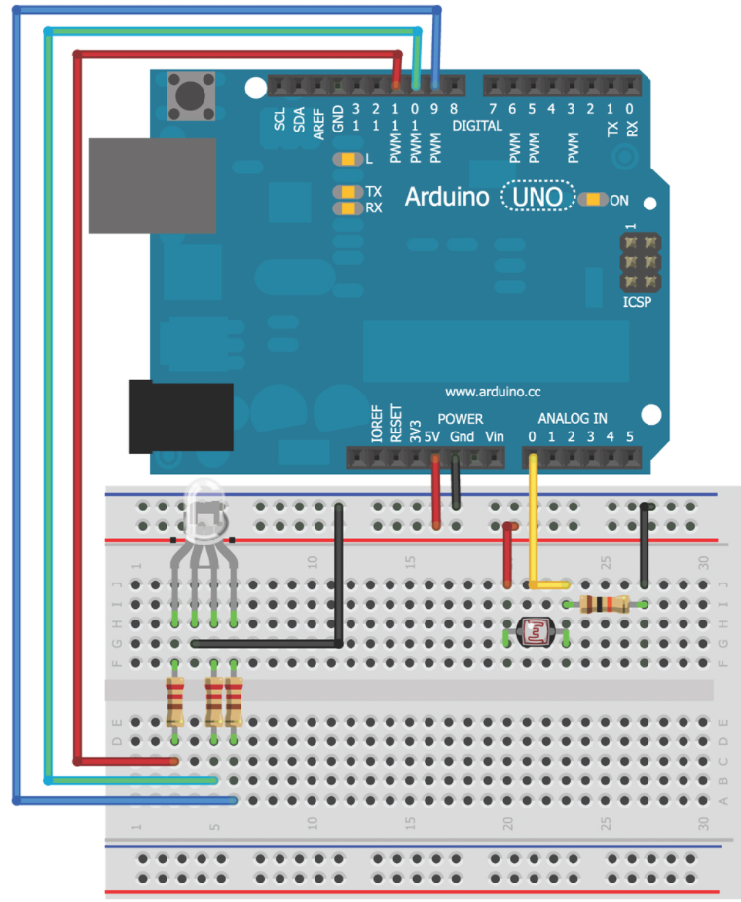
Add the Photoresistor
Insert the Photo Diode into Analog In 0

Slide 23
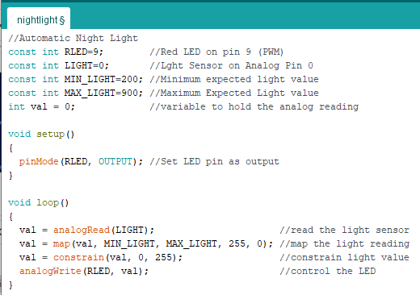
The code

